Slide 1

DE-ZOOMCAMP WEEK 4
This Photo by Unknown Author is licensed under CC BY-SA-NC

Slide 2
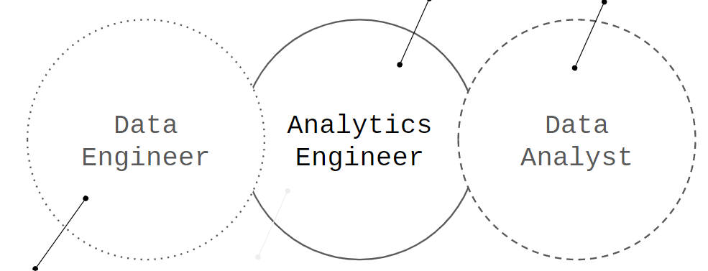
Analytical Engineering
Analytical engineering refers to applying engineering principles and techniques to the analysis and interpretation of data.
It involves using data to solve problems, optimize processes, and make informed decisions.
Analytical engineering encompasses a range of activities, including
data collection
data cleaning and preparation
data analysis
data visualization.
It often involves working with large datasets and complex algorithms to extract insights and identify patterns.

Slide 3
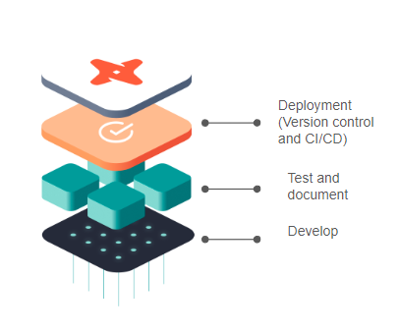
DBT - Data Build Tool
It is an open-source command-line tool that helps with data transformation and management in modern data warehouses.
DBT allows data analysts and engineers to define the transformations they want to apply to data in a structured and modular way, using SQL or Jinja (a templating language for Python).
DBT is often used in combination with other data warehousings tools like Snowflake, BigQuery, Redshift, or Postgres.
It provides functionality for modeling data, creating and managing pipelines, testing and documenting data, and deploying data models to production.
DBT's modularity and versioning features make it easier to collaborate on data projects and maintain high quality and consistency in the codebase.

Slide 4
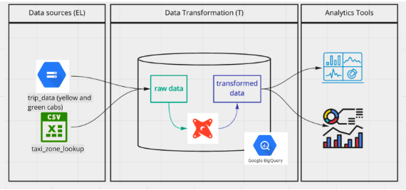
How does DBT works?
It connects to the raw data in the data warehouse
Using build models, the data is transformed using the data warehouse resource
The transformed data is then stored in the data warehouse
Analytics tools are then connected to the data to analyze or visualize it.

Slide 5
DBT Tips I learned
To create a new DBT project
dbt init
DBT functions are called micro and called inside ‘{{ micro }}’
To use packages in DBT, they must be defined in a package.yml file
Data sources can be defined in the schema file so the source micro can quickly call them
Seeds are an alternate source of data:
They are stored in the repo that contains your DBT files
They are helpful when the file is small, and changes are not frequent.
DBT development takes place in a repo other than the main
DBT deployment run from the main repo

Slide 6
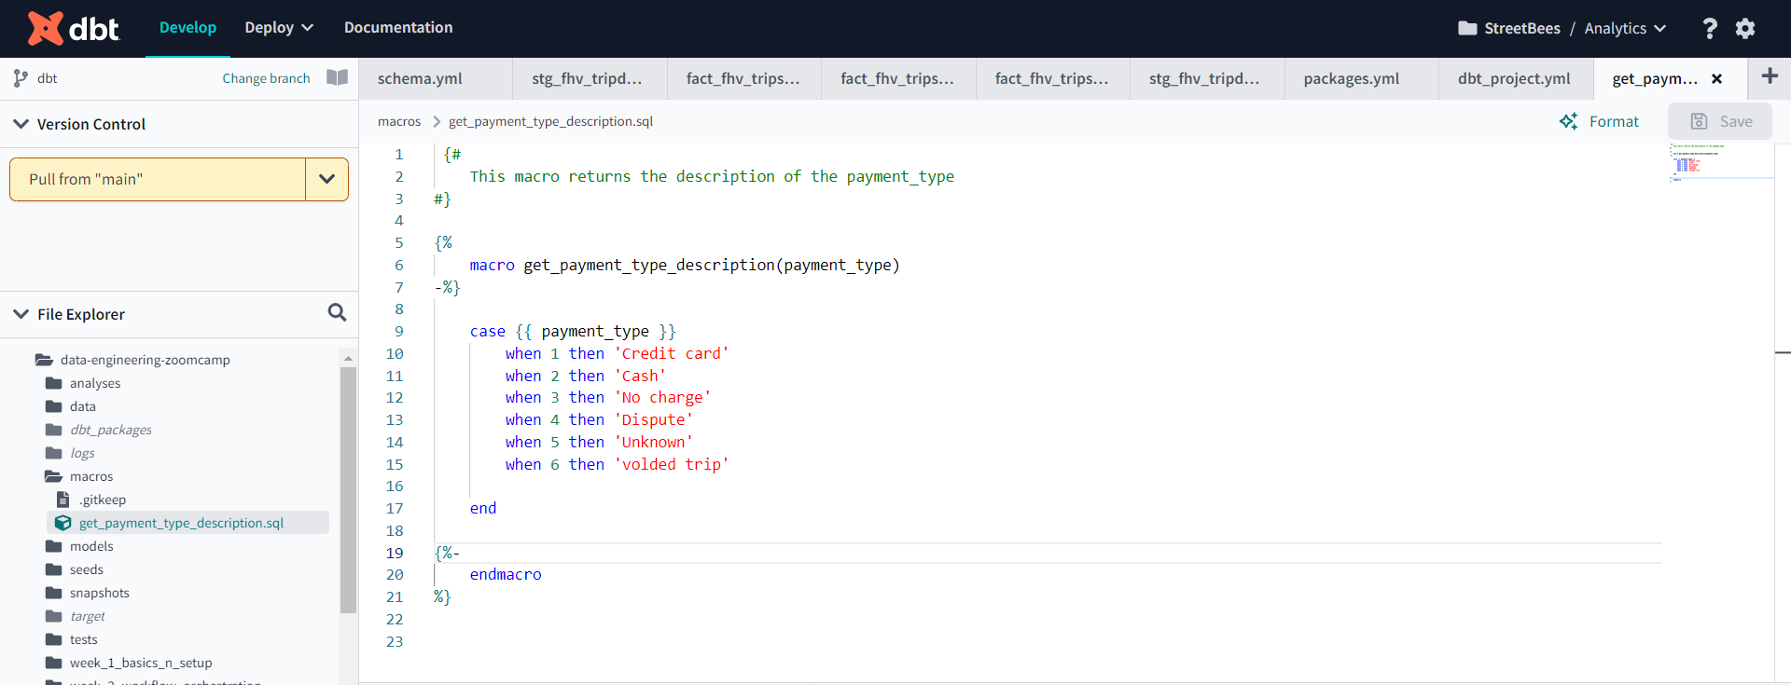
DBT Micros
Definition of micro
Use of micro

Slide 7
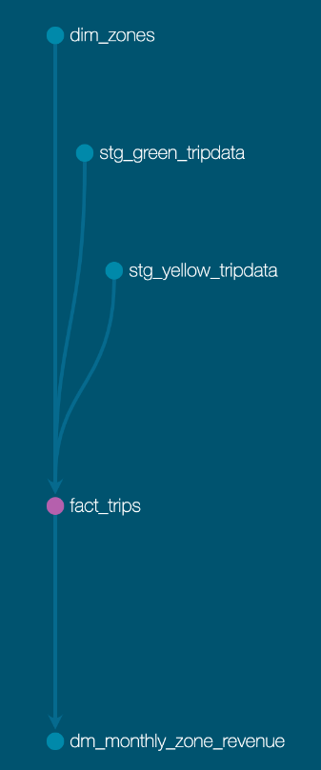
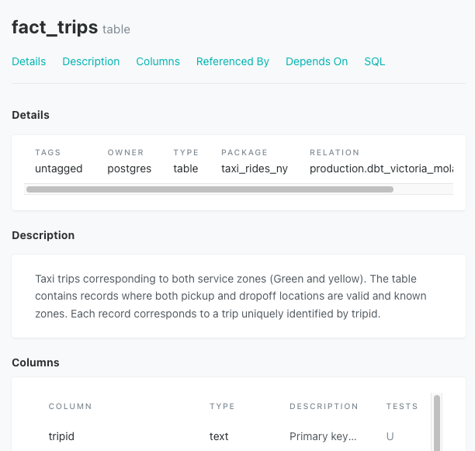
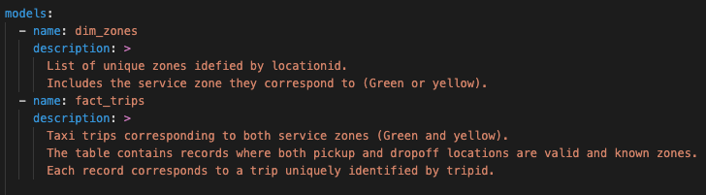
DBT Documentation
DBT provides a way to generate documentation for your DBT project and render it as a website.
The documentation for your project includes:
Information about your project
Information about your data warehouse (Column names and data types)

Slide 8
DBT Fun Fact
To use DBT Cloud for transformation, the DBT project and all datasets in your data warehouse must be in the exact location. NOTE: EU and Europe-west1 are not the same.
Don’t repeat my mistake

